Slide 1

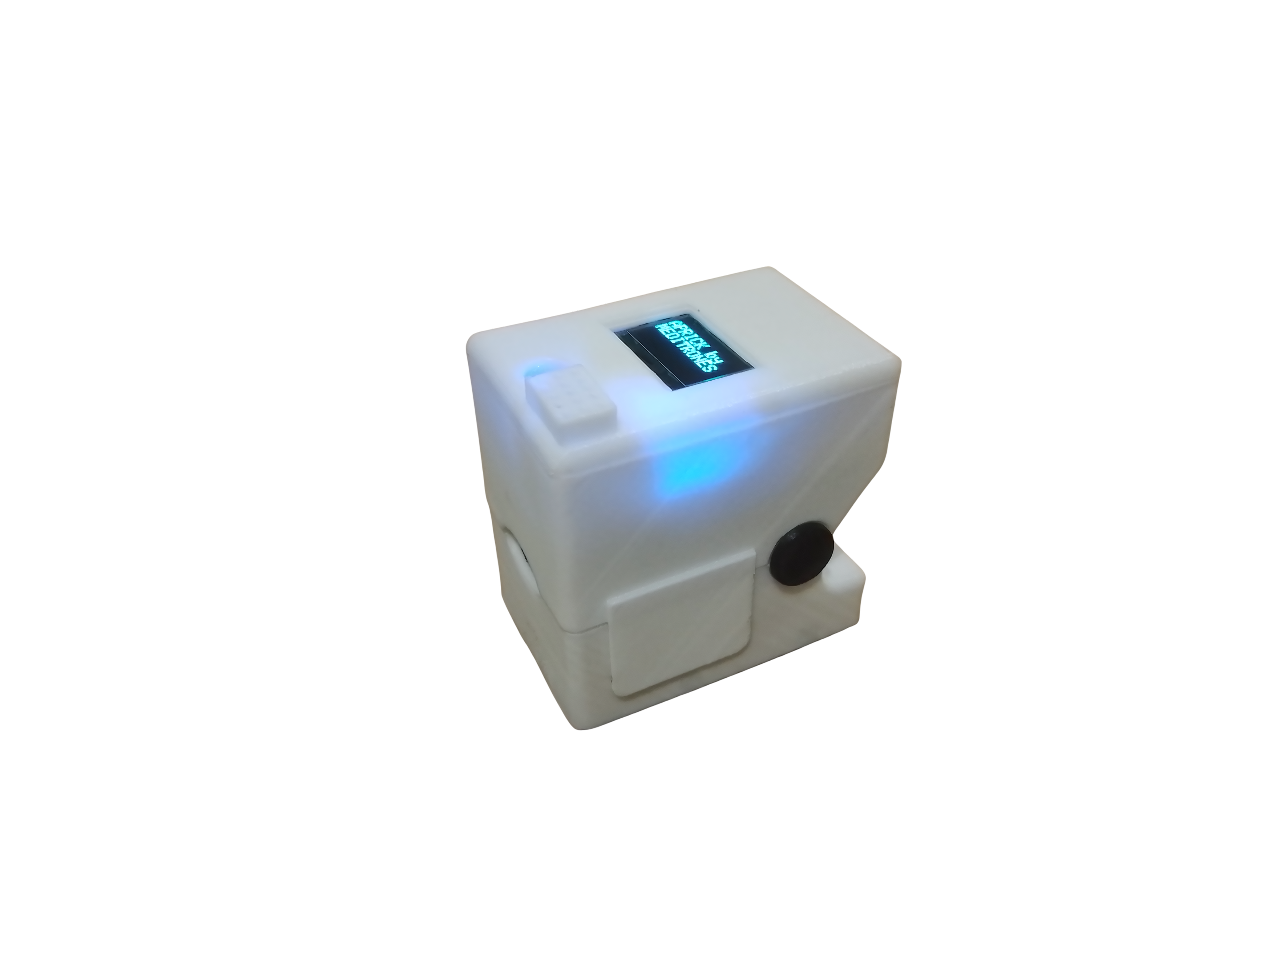

NON-INVASIVE GLUCOMETER
Product Overview
Aazir.M.A.M 220005R
Boralugoda.M.S 220074B
Liyanage.D.L.B.B 220362G
Madusanka.S.P.S 220374U

Slide 2
Problem Specification
Diabetes is a serious condition affecting approximately 20% of adults in Sri Lanka.
Regular monitoring of blood glucose levels is essential to manage diabetes.
Traditional glucose monitoring methods are invasive, often causing discomfort and potentially leading to infections.

Slide 3
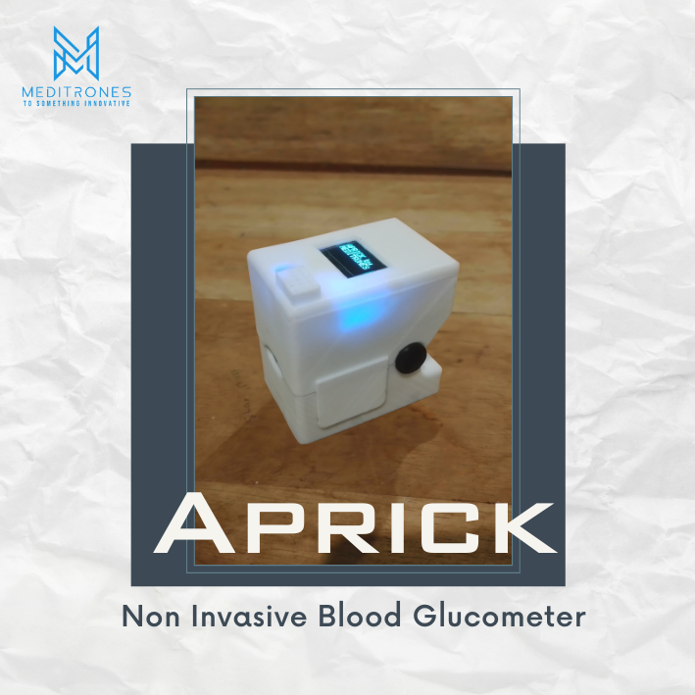
Our solution
Our non-invasive glucometer offers a convenient and pain-free method for individuals with diabetes to get a good indication of their blood glucose levels, ultimately improving diabetes management and patient outcomes.

Slide 4
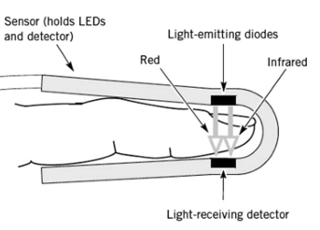
Method
The blood glucose level is calculated by analyzing the absorption of near-infrared light.
A wavelength of 940nm is used because it optimizes glucose molecule absorption and minimizes the absorption by Melanin.

Slide 5
METHODOLOGY
NIR LED
(940 nm)
Finger
Receiver Module
Display
Micro Controller
Signal Conditioning

Slide 6
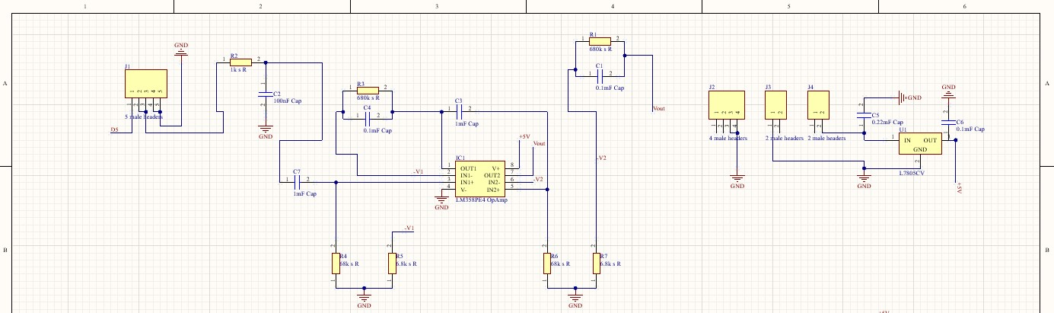
CIRCUIT DIAGRAM (FILTERING AND AMPLIFYING)

Slide 7
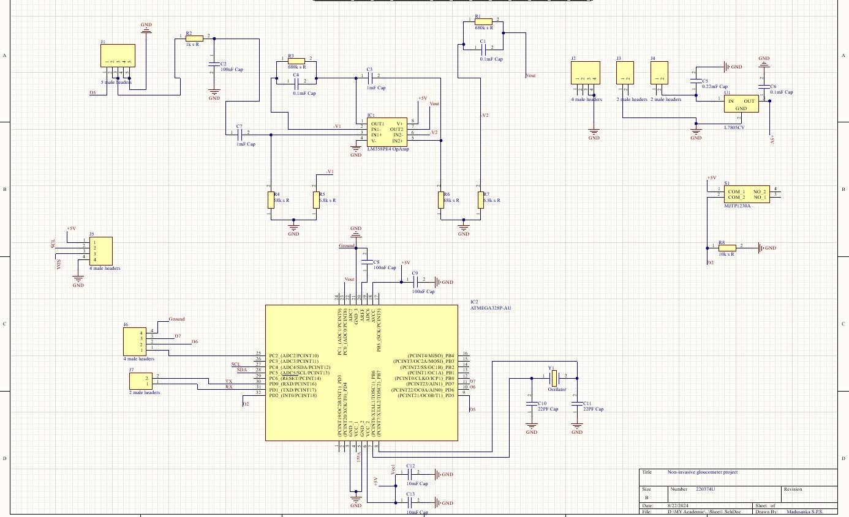
PCB – SCHEMATIC diagram

Slide 8
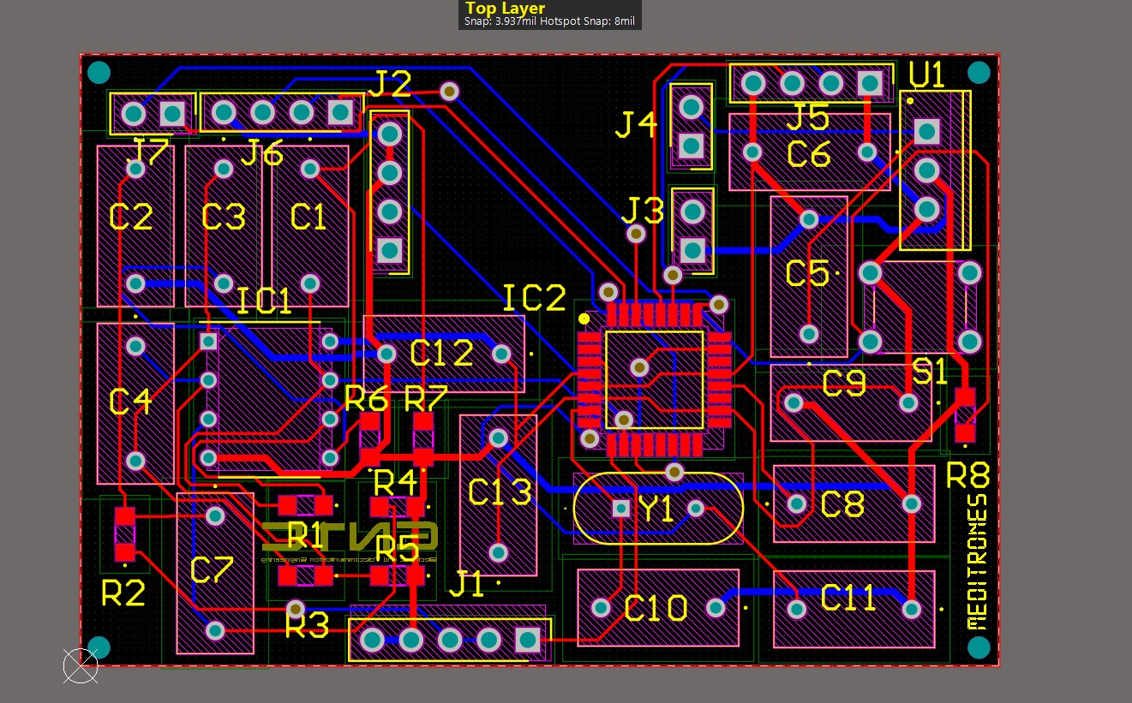
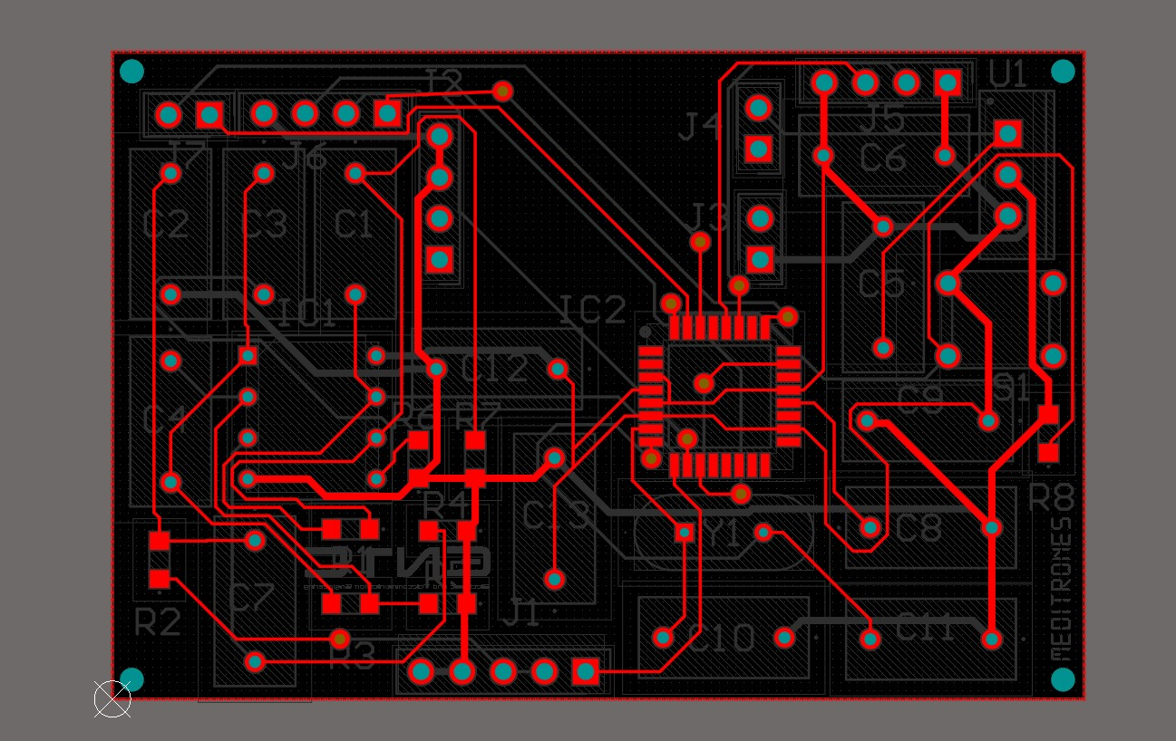
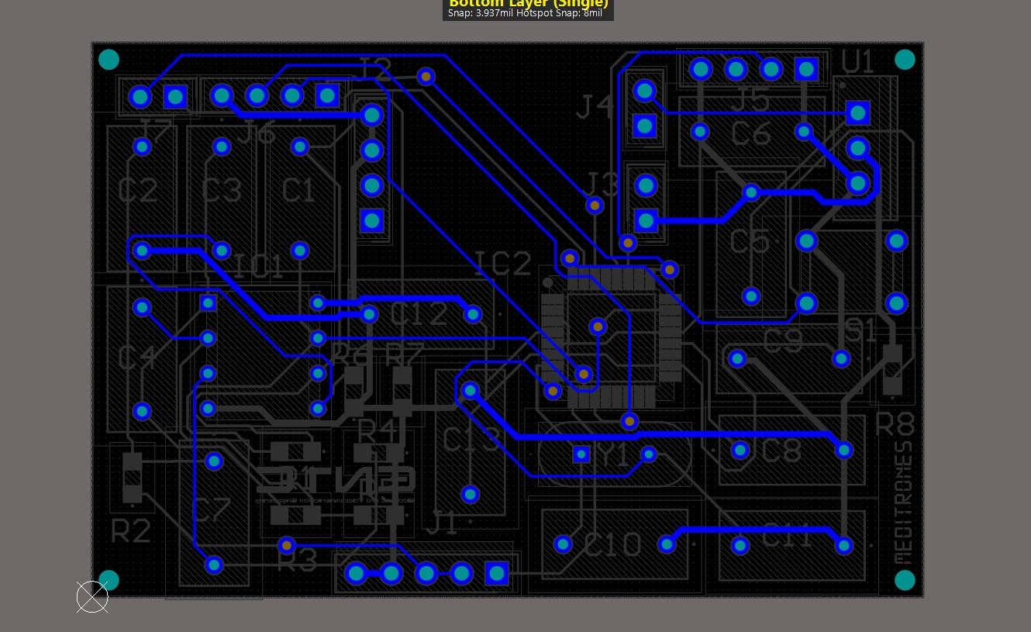
Main PCB - DESIGN

Slide 9
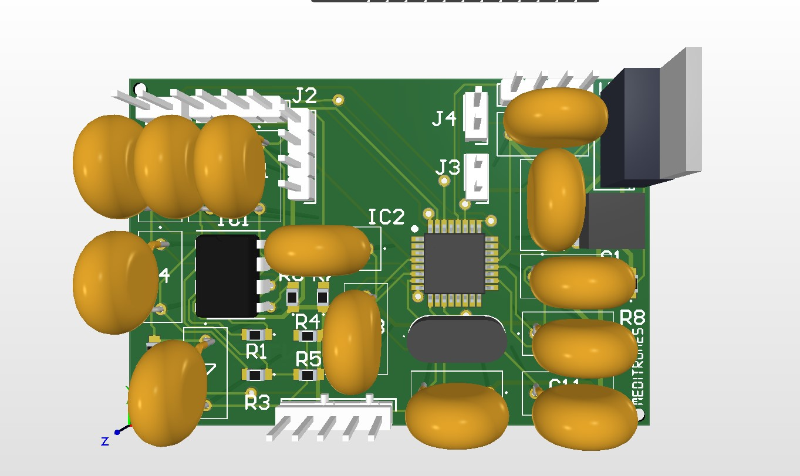
Main PCB - 3D Model

Slide 10
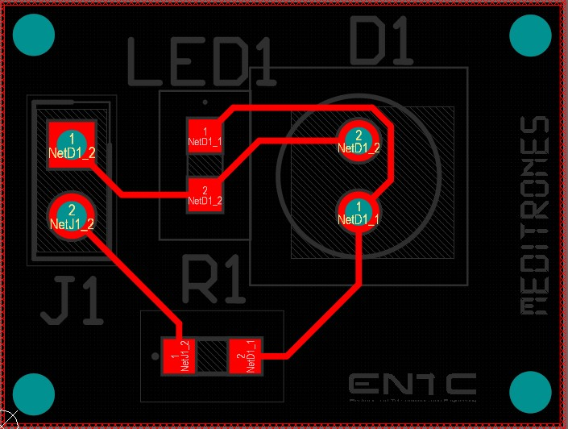
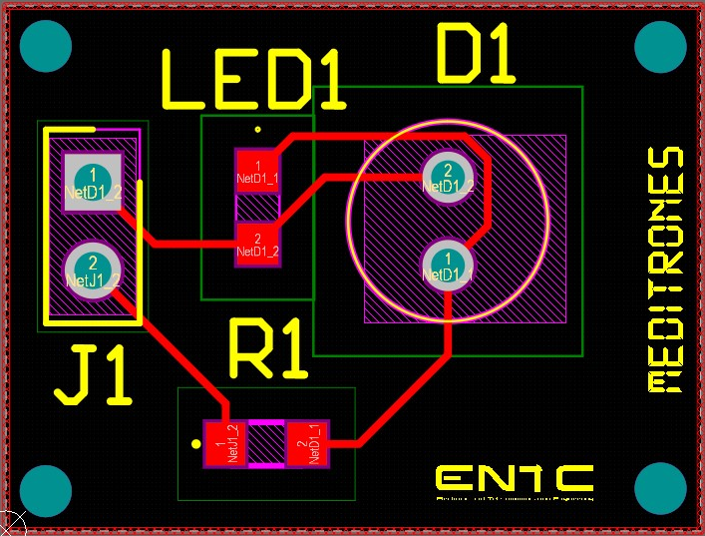
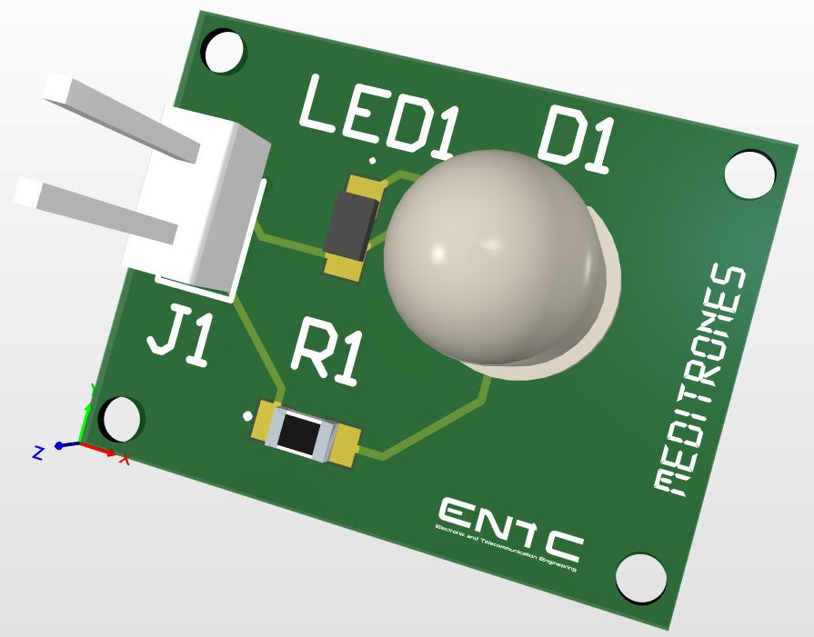
EMITTER PCB

Slide 11
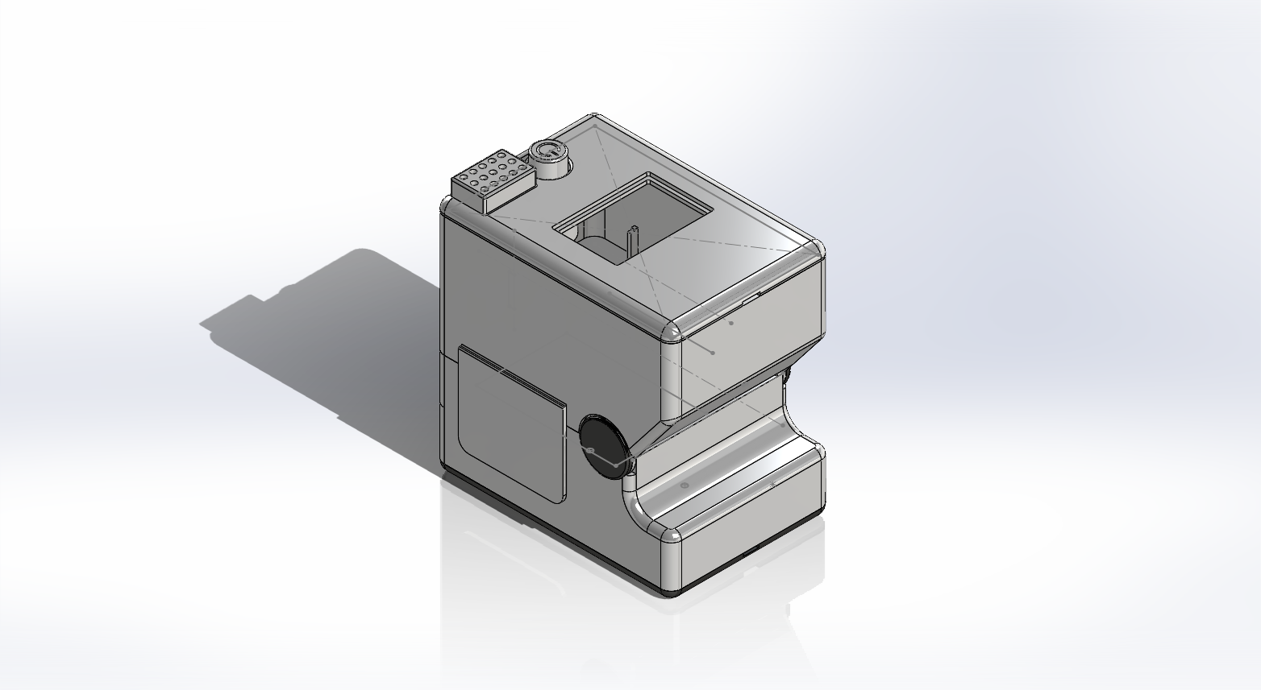
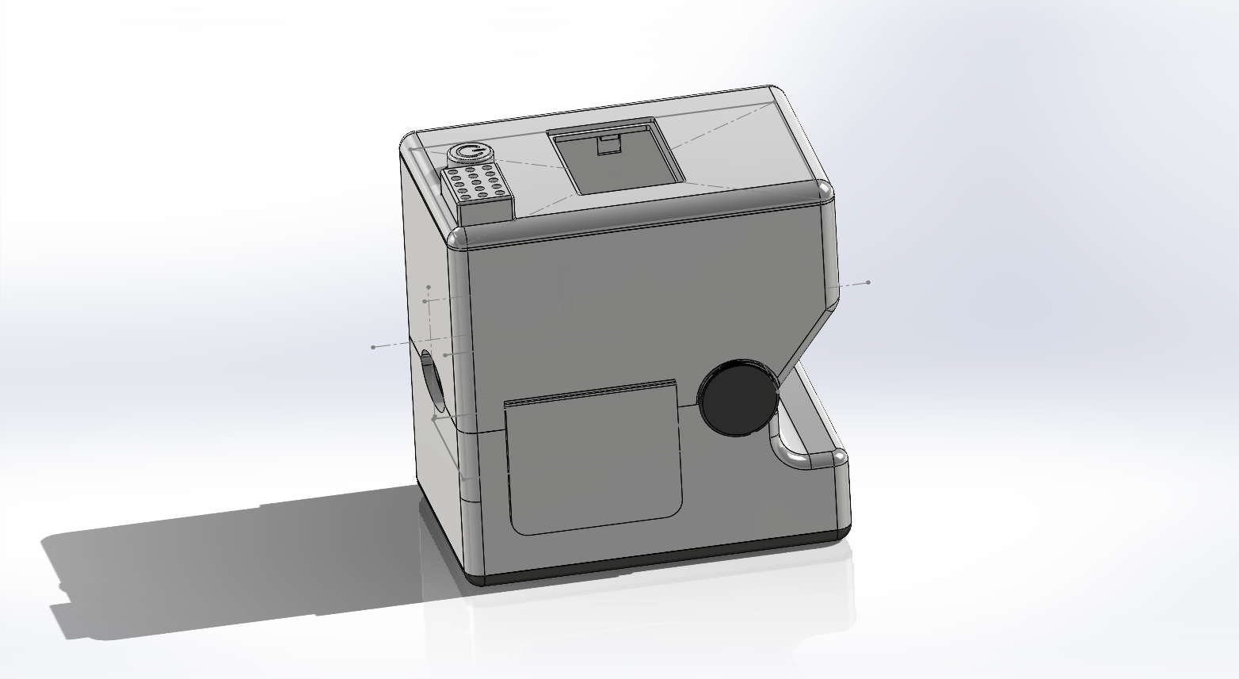
Enclosure

Slide 12
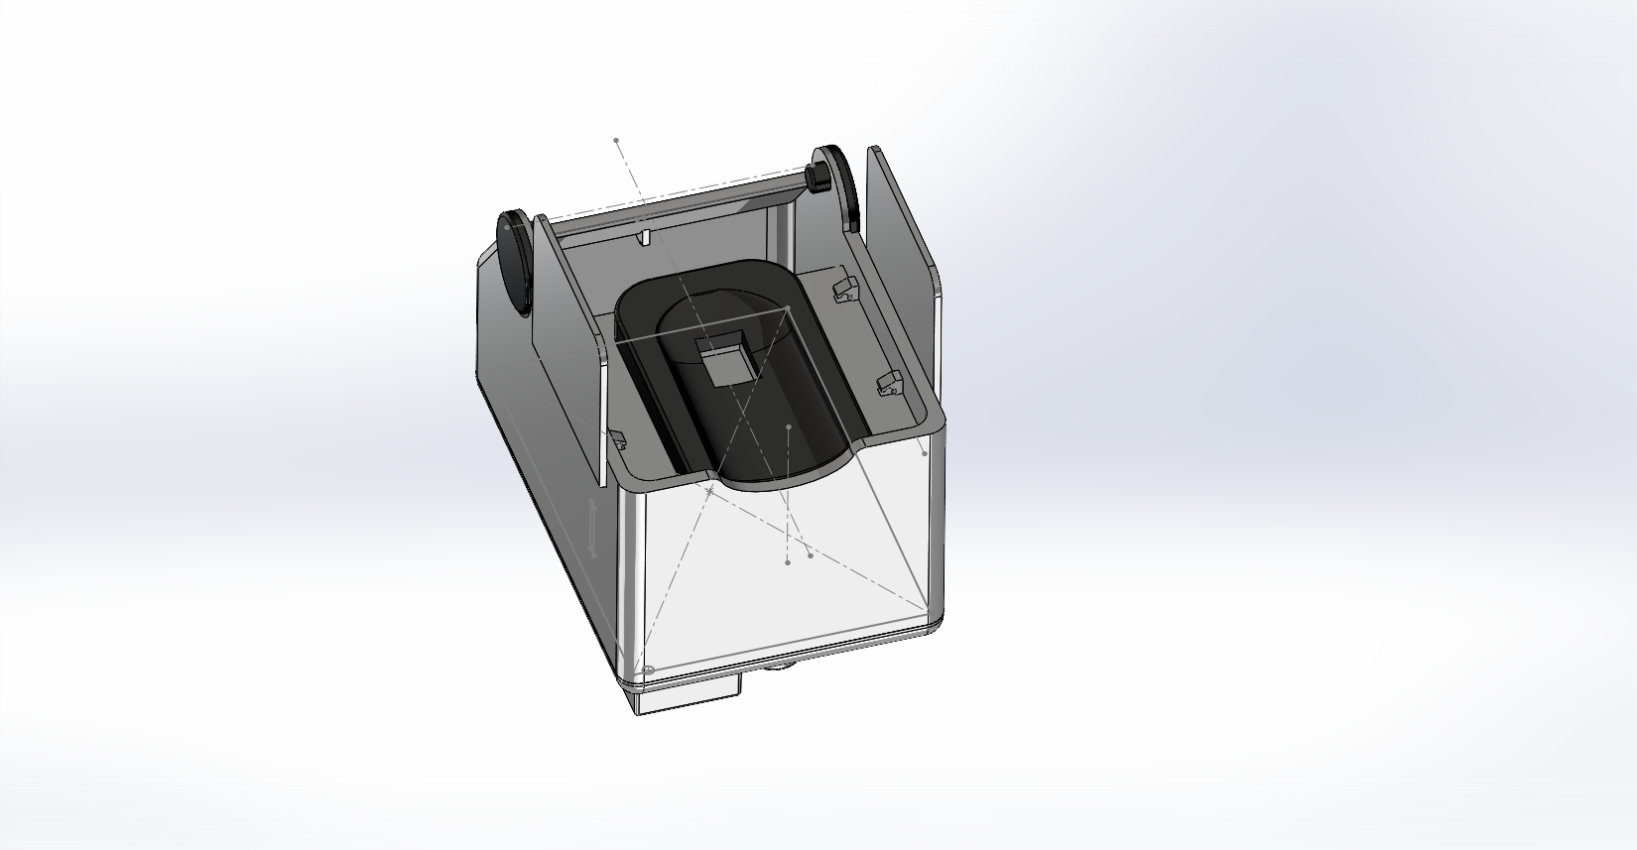
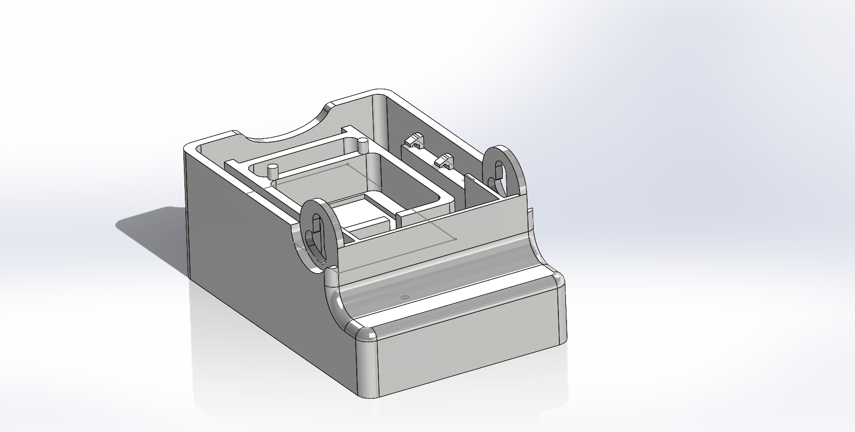
Inside View

Slide 13
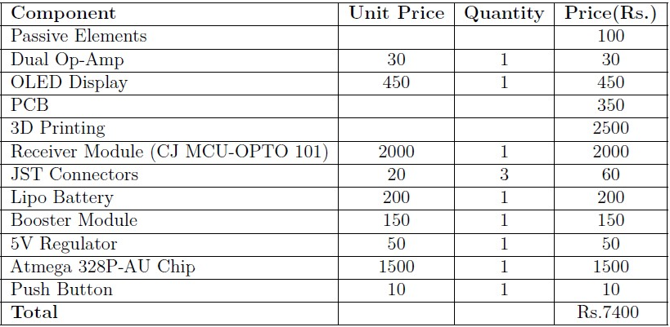
Budget allocATION

Slide 14
MARKETING PLAN
Our marketing strategy will focus on educating the public about the convenience and safety of our non-invasive glucometer for at-home use, emphasizing the importance of consulting healthcare professionals for diagnosis and treatment.
We will collaborate with local pharmacies, and clinics, and run online campaigns targeting those managing diabetes. The glucometer will be available at local pharmacies and through an online store, ensuring easy access across Sri Lanka.
Our after-sale service will guide proper use, customer support, and routine updates, reinforcing that the device is a supplementary tool and not a replacement for professional medical advice.

Slide 15
Task allocation
• Research: Aazir, Manuri, Banuka • Circuit Development and Implementation: Aazir, Banuka, Sahan • PCB Design: Sahan • Enclosure Design: Aazir, Manuri • Code: Aazir, Banuka • Documentation: Manuri, Banuka

Slide 16


THANK YOU
For further reference

Slide 17

Q & A

